Slide 1
Managing Research Data
Survival Skills Workshop Series
Notes:
Use the term Data Management Plan?

Slide 3
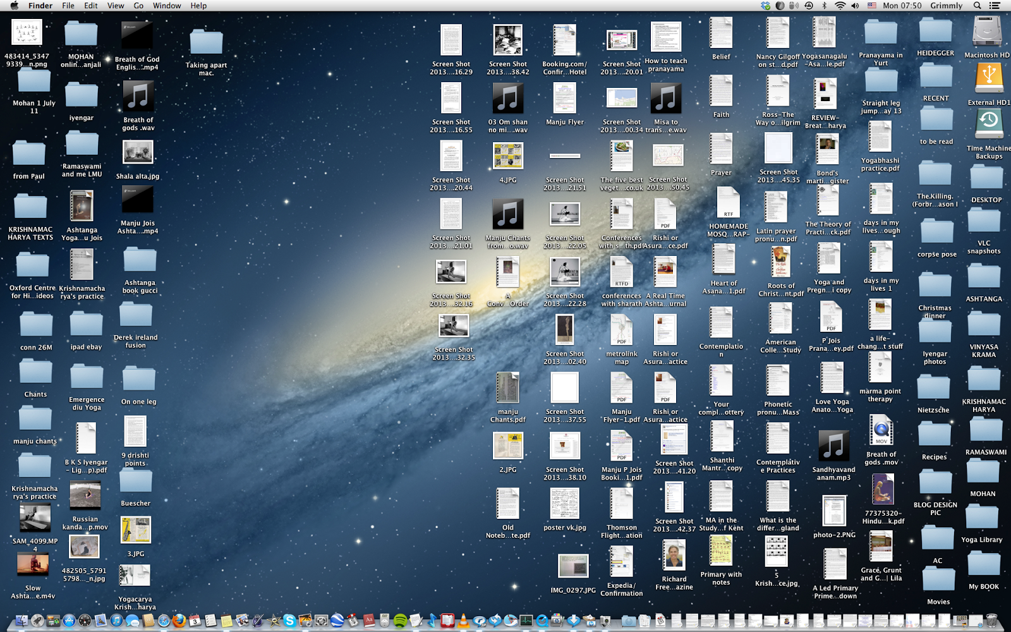
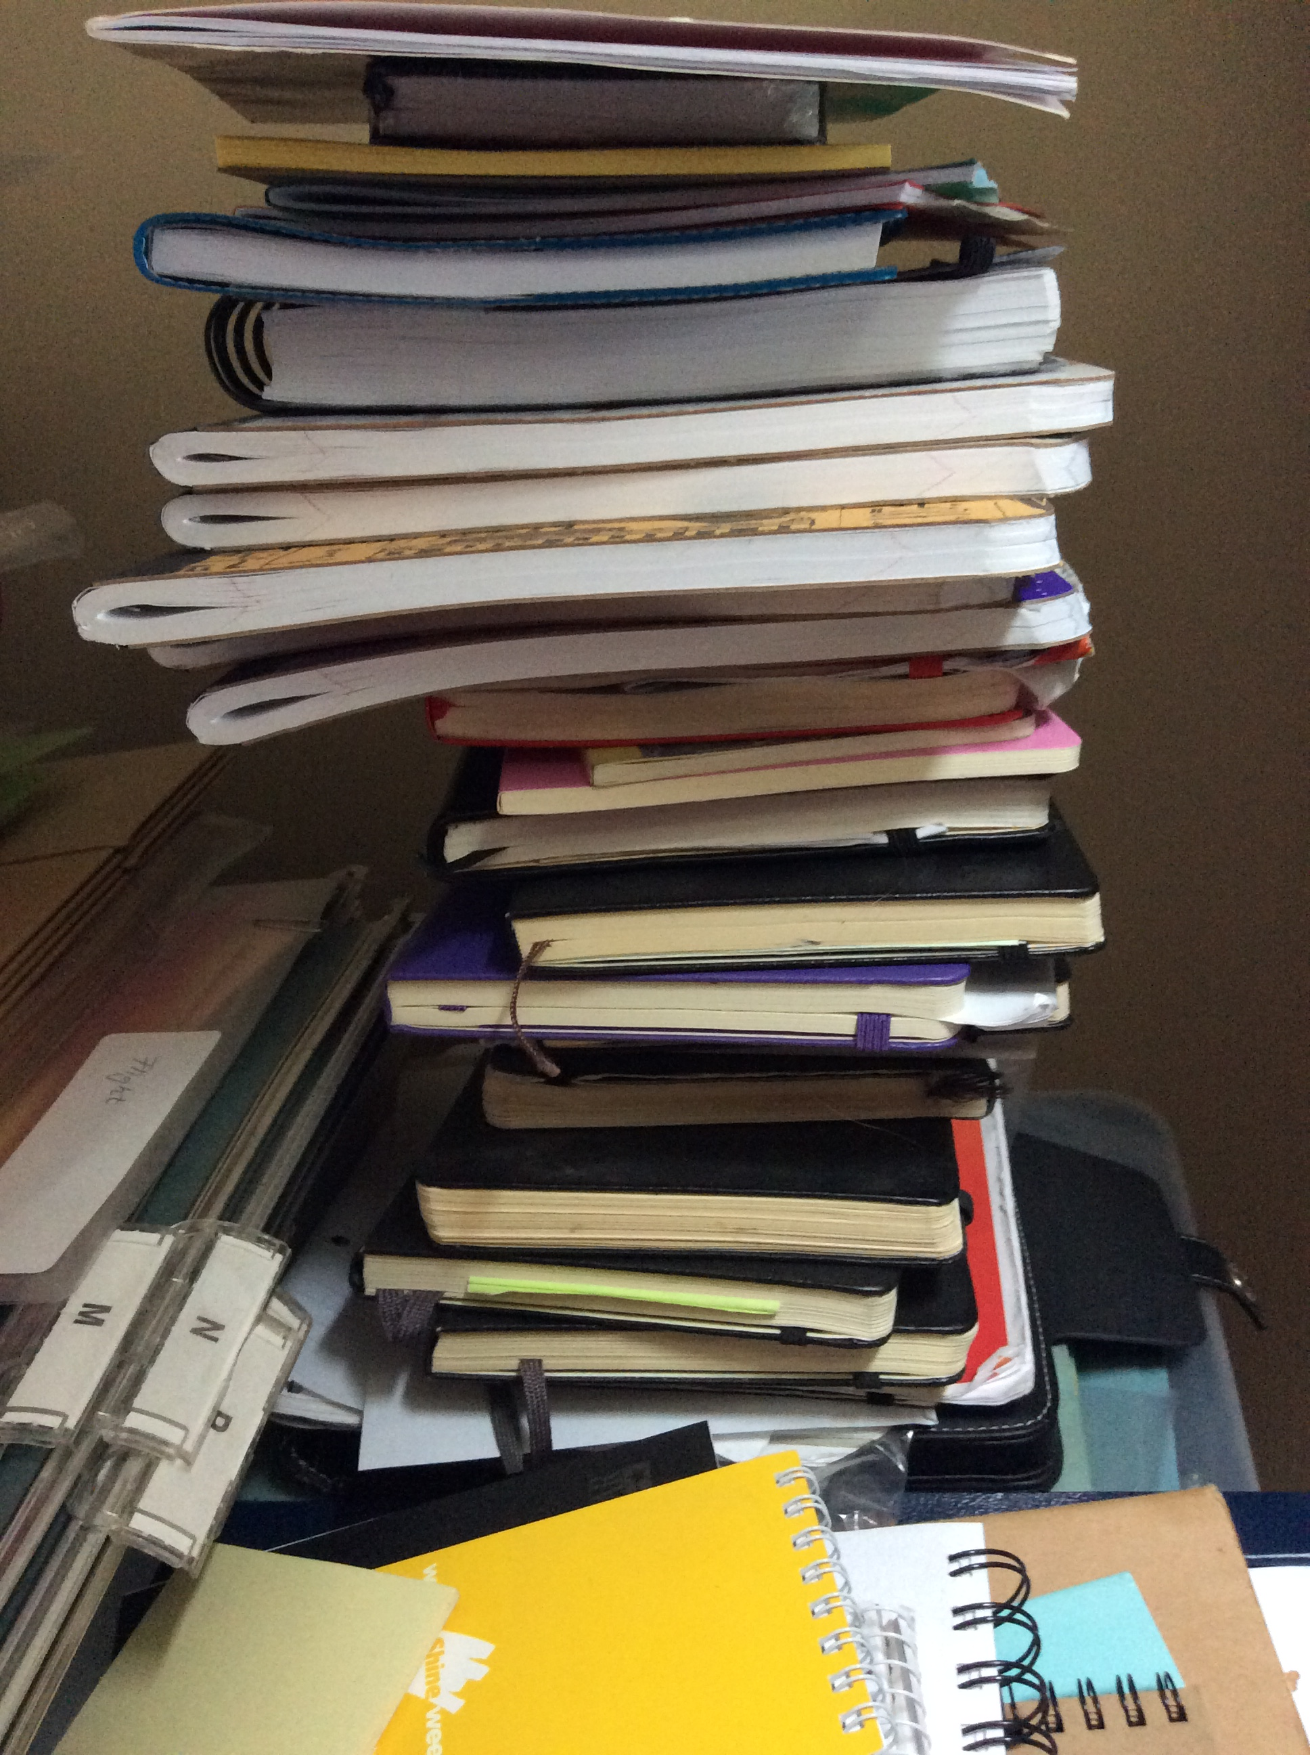

Managing Research Data
Why think about these things?
Discoverability
Others
You
Collaboration
Reproducibility

Slide 4


Amanda’s Research Project
 | 20121103_ra179.7dec12.1_g.fits
 | 20121103_ra179.7dec12.1_r.fits
 | 20121103_ra179.7dec12.1_spec.fits
 | 20121104_ra180.0dec12.1_g.fits
 | 20121104_ra180.0dec12.1_r.fits
 | 20121104_ra180.0dec12.1_spec.fits
 | galaxy1_g_crop.fits
 | galaxy1_r_crop.fits
 | galaxy1_spec_restframe.fits
 | galaxy2_g_crop.fits
 | galaxy2_r_crop.fits
 | galaxy2_spec_restframe.fits
observations
 | 1303.7762.pdf
 | 2dfft.py
 | BHmass.py
 | E&M class notes
 | mass & pitch angle scatter.png
 | paper on mass estimates.pdf
 | redshift(z)histogram
 | results
 | spiral paper.pdf
Notes:
Handouts option – pass out a worksheet with this same representation, ask groups to discuss for a few minutes
ZOOM VIDEO FEED AT BOTTOM LEFT CORNER IN LL123

Slide 5
File Naming
Be descriptive!
Is a date appropriate? YYYYMMDDleafcolor.dat
Are there multiple observers? YYYYMMDD_counts_ABS.csv
Use – or _ or capitalization instead of spaces
this file.docx
ThisFile.docx
this_file.docx
Don’t use special characters like !@#$%^&
File extensions are important (.txt, .csv, .exe)
Be consistent – are there guidelines already in place?
Notes:
The example is high-level nomenclature
http://classic.sdss.org/dr6/dm/flatFiles/spSpec.html
https://www.sdss.org/dr14/manga/manga-data/data-model/
Long file names, nested folders (long path) can cause problems with certain tools like command line

Slide 6
File Naming
Be descriptive!
Is a date appropriate? YYYYMMDDleafcolor.dat
Are there multiple observers? YYYYMMDD_counts_ABS.csv
Use – or _ or capitalization instead of spaces
this file.docx
ThisFile.docx
this_file.docx
Don’t use special characters like !@#$%^&
File extensions are important (.txt, .csv, .exe)
Be consistent – are there guidelines already in place?
Notes:
The example is high-level nomenclature
http://classic.sdss.org/dr6/dm/flatFiles/spSpec.html
https://www.sdss.org/dr14/manga/manga-data/data-model/
Long file names, nested folders (long path) can cause problems with certain tools like command line

Slide 7
File Naming
Be descriptive!
Is a date appropriate? YYYYMMDDleafcolor.dat
Are there multiple observers? YYYYMMDD_counts_ABS.csv
Use – or _ or capitalization instead of spaces
this file.docx
ThisFile.docx
this_file.docx
Don’t use special characters like !@#$%^&
File extensions are important (.txt, .csv, .exe)
Be consistent – are there guidelines already in place?
Notes:
The example is high-level nomenclature
http://classic.sdss.org/dr6/dm/flatFiles/spSpec.html
https://www.sdss.org/dr14/manga/manga-data/data-model/
Long file names, nested folders (long path) can cause problems with certain tools like command line

Slide 8
File Naming
Be descriptive!
Is a date appropriate? YYYYMMDDleafcolor.dat
Are there multiple observers? YYYYMMDD_counts_ABS.csv
Use – or _ or capitalization instead of spaces
this file.docx
ThisFile.docx
this_file.docx
Don’t use special characters like !@#$%^&
File extensions are important (.txt, .csv, .exe)
Be consistent – are there guidelines already in place?
Notes:
The example is high-level nomenclature
http://classic.sdss.org/dr6/dm/flatFiles/spSpec.html
https://www.sdss.org/dr14/manga/manga-data/data-model/
Long file names, nested folders (long path) can cause problems with certain tools like command line

Slide 9
File Naming
Be descriptive!
Is a date appropriate? YYYYMMDDleafcolor.dat
Are there multiple observers? YYYYMMDD_counts_ABS.csv
Use – or _ or capitalization instead of spaces
this file.docx
ThisFile.docx
this_file.docx
Don’t use special characters like !@#$%^&
File extensions are important (.txt, .csv, .exe)
Be consistent – are there guidelines already in place?
Notes:
The example is high-level nomenclature
http://classic.sdss.org/dr6/dm/flatFiles/spSpec.html
https://www.sdss.org/dr14/manga/manga-data/data-model/
Long file names, nested folders (long path) can cause problems with certain tools like command line

Slide 10
File Naming
Be descriptive!
Is a date appropriate? YYYYMMDDleafcolor.dat
Are there multiple observers? YYYYMMDD_counts_ABS.csv
Use – or _ or capitalization instead of spaces
this file.docx
ThisFile.docx
this_file.docx
Don’t use special characters like !@#$%^&
File extensions are important (.txt, .csv, .exe)
Be consistent – are there guidelines already in place?
Notes:
The example is high-level nomenclature
http://classic.sdss.org/dr6/dm/flatFiles/spSpec.html
https://www.sdss.org/dr14/manga/manga-data/data-model/
Long file names, nested folders (long path) can cause problems with certain tools like command line

Slide 11
File Naming
Be descriptive!
Is a date appropriate? YYYYMMDDleafcolor.dat
Are there multiple observers? YYYYMMDD_counts_ABS.csv
Use – or _ or capitalization instead of spaces
this file.docx
ThisFile.docx
this_file.docx
Don’t use special characters like !@#$%^&
File extensions are important (.txt, .csv, .exe)
Be consistent – are there guidelines already in place?
Notes:
The example is high-level nomenclature
http://classic.sdss.org/dr6/dm/flatFiles/spSpec.html
https://www.sdss.org/dr14/manga/manga-data/data-model/
Long file names, nested folders (long path) can cause problems with certain tools like command line

Slide 12
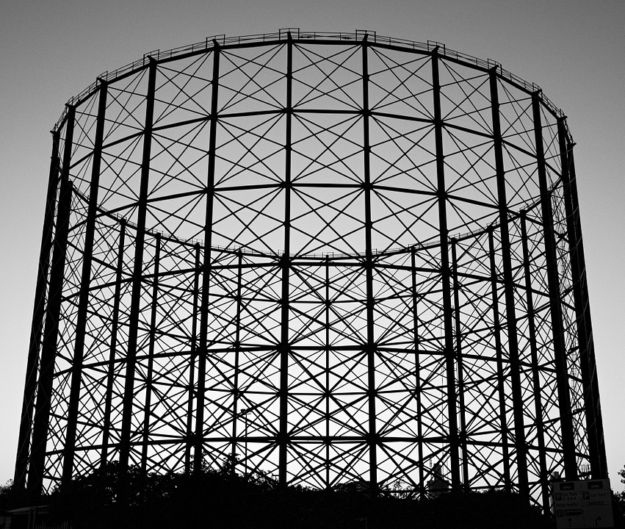
File Organization
new_research_project
data
raw_data
processed_data
analysis
question1
question2
literature
write_up
Notes:
Organization = you can search and find
Being able to share is secondary
For certain projects, dynamically linking, if Excel is your primary tool interaction with your data

Slide 13
README files
Create README for each file or data set
Write as plain text file
Information to include:
https://libraries.ou.edu/content/how-make-readmetxt-file

Slide 14
README files
Create README for each file or data set
Write as plain text file
Information to include:
https://libraries.ou.edu/content/how-make-readmetxt-file

Slide 15
README files
Create README for each file or data set
Write as plain text file
Information to include:
https://libraries.ou.edu/content/how-make-readmetxt-file
Notes:
Go to libraries.ou.edu and search for readme file

Slide 16
Data organization
Spreadsheet
Tabulate data
Edited directly
Quickly analyze, make charts
Flat files (csv)
Read by many programs (including excel)
Programming language to analyze or connect to other tables
Database
Relational data
Interact by specific software (multi-user friendly)
Can handle large data sets
Complex searching
Notes:
Spreadsheets are a good place to start
Add comparison to CSV – easy to read, no tabs, imports to most programs, can be connected programming language

Slide 17
Amanda’s Research Project
 | 20121103_ra179.7dec12.1_g.fits
 | 20121103_ra179.7dec12.1_r.fits
 | 20121103_ra179.7dec12.1_spec.fits
 | 20121104_ra180.0dec12.1_g.fits
 | 20121104_ra180.0dec12.1_r.fits
 | 20121104_ra180.0dec12.1_spec.fits
 | galaxy1_g_crop.fits
 | galaxy1_r_crop.fits
 | galaxy1_spec_restframe.fits
 | galaxy2_g_crop.fits
 | galaxy2_r_crop.fits
 | galaxy2_spec_restframe.fits
observations
 | 1303.7762.pdf
 | 2dfft.py
 | BHmass.py
 | E&M class notes
 | mass & pitch angle scatter.png
 | paper on mass estimates.pdf
 | redshift(z)histogram
 | results
 | spiral paper.pdf
Notes:
Handouts option – pass out a worksheet with this same representation, ask groups to discuss for a few minutes
ZOOM VIDEO FEED AT BOTTOM LEFT CORNER IN LL123

Slide 18
BlackHoleMass_SpiralGalaxy
analysis
plots
 | mass_pitchangle_scatter.png
 | redshift_histogram.png
 | galaxy1_g_crop.fits
 | galaxy1_r_crop.fits
 | galaxy1_spec_restframe.fits
 | galaxy2_g_crop.fits
 | galaxy2_r_crop.fits
 | galaxy2_spec_restframe.fits
 | README.txt
 | README_methods.txt
 | 2dfft.py
 | BHmass.py
 | results.csv
 | README.txt
data
processed
 | 20121103_ra179.7dec12.1_g.fits
 | 20121103_ra179.7dec12.1_r.fits
 | 20121103_ra179.7dec12.1_spec.fits
 | 20121104_ra180.0dec12.1_g.fits
 | 20121104_ra180.0dec12.1_r.fits
 | 20121104_ra180.0dec12.1_spec.fits
 | README.txt
raw
 | BHmass_pitch.bib
 | KormandyHo2013.pdf
 | Lusso2010.pdf
 | Vertergaard2006.pdf
literature
 | README.txt

Slide 19
More on managing data
Formatting data for analysis; Tidy Data 101 – Thur. 10am
Backups 101 – Fri. 10am
Version control
Data Management Plans - Mark Laufersweiler, Research Data Specialist
Notes:
Put these on the handout!

Slide 20
Find more resources and upcoming events!
Impact Challenge https://libraries.ou.edu/ impactchallenge
Feb 4-8: Make your data discoverable
Feb. 11-15: Share software with Github
Feb. 18-22: Understand DOIs
Carpentries two-day workshops https://libraries.ou.edu/ carpentries
Information Specialists @ DAVIS https://libraries.ou.edu/davis
Digital Scholarship Lab https://libraries.ou.edu/dsl
Digital Skills Hub (coming soon)

Slide 21
Please take 5 min to help us improve
Survey link
bit.ly/oulib_davis_workshop
Today’s topic
Survival Skills: Managing Research Data

